Slide 1
Smarticle – Demo 3

Slide 2
Little about our progress since the last demo:
Since our previous demo we have began creating our UI, some features and of course tests for them. The main goal was to complete the styling of the app and finish our 2 main features- "Create article“ and “Search Article”.

Slide 3
How we worked:
First we created a base.html file and logo for our project so we would have a template how the app will appear. Since we had 2 main features that requires a lot of work and we are a team of 5, we decided to work in smaller groups on the same branch.
In addition, we created issues for everything we think that's missing from the app and set priority for each one of them from low to high so we will advance as much as we can.

Slide 4
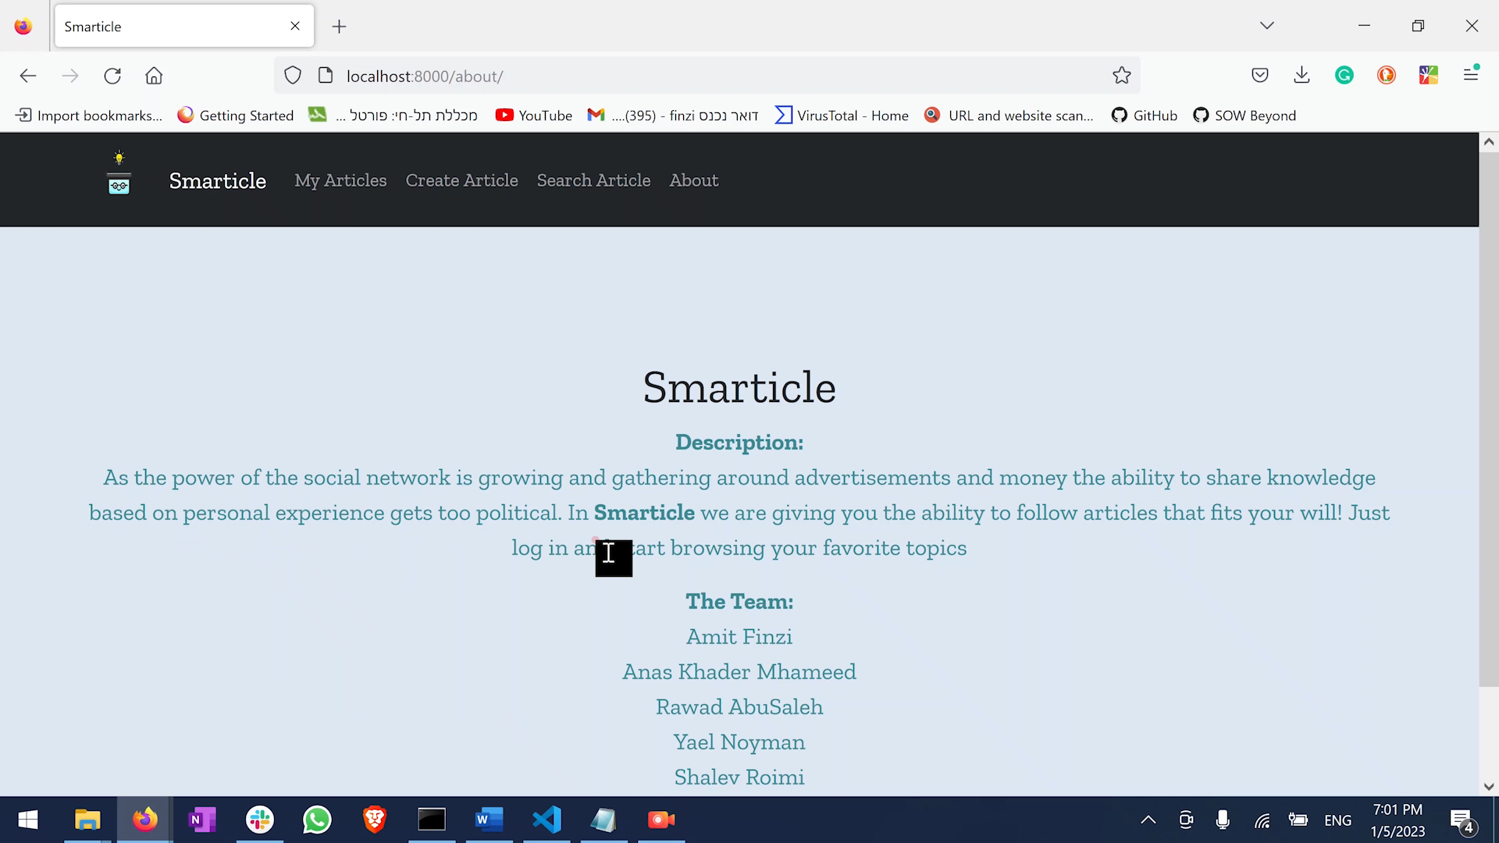

Features Demo using our UI

Slide 5
About the tests
In the tests we wanted to make sure the app won't crash and would know how to handle not only normal use but also edge cases. For example we wanted to make sure every page loads up properly (for normal use), searching for article that doesn't exist or searching for articles without any search content (for edge cases).
https://github.com/redhat-beyond/Smarticle/tree/main/projboard/tests

Slide 6
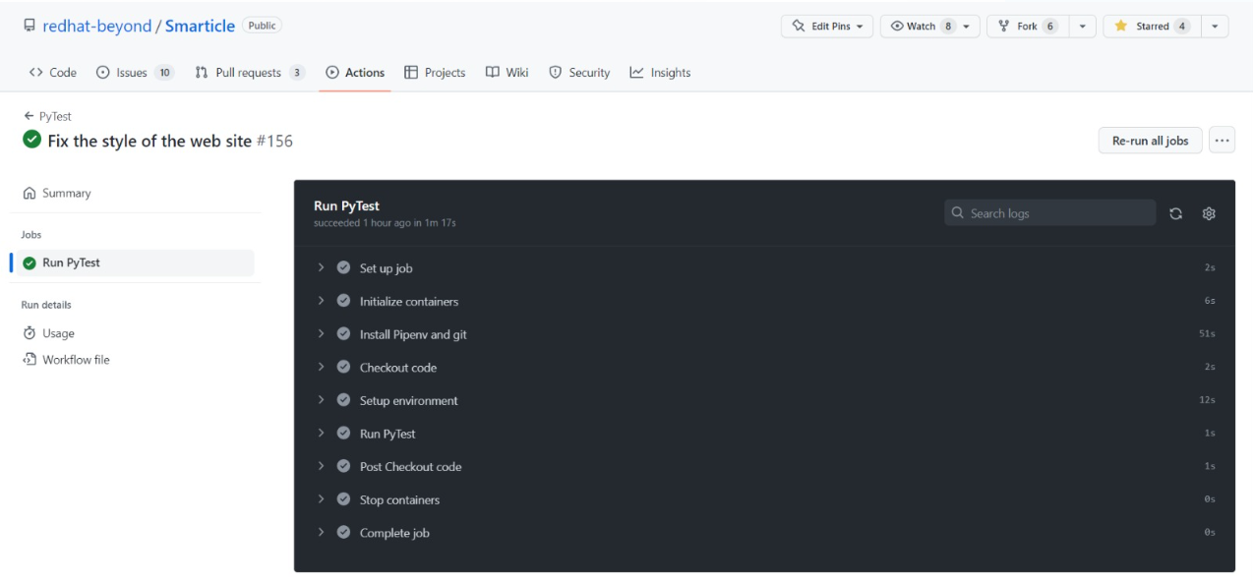
A demonstration of tests being run in GitHub actions

Slide 7
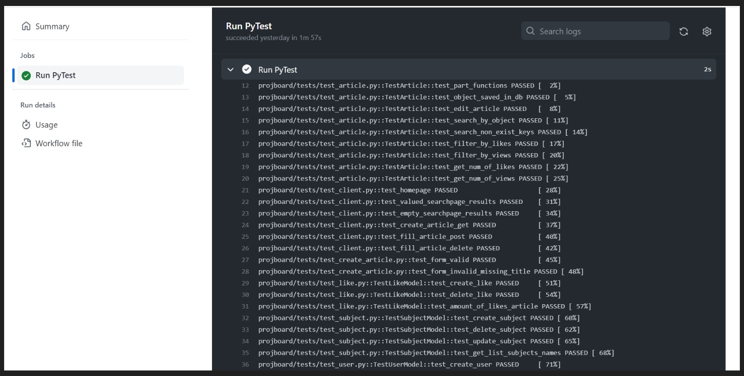
model
view

Slide 8
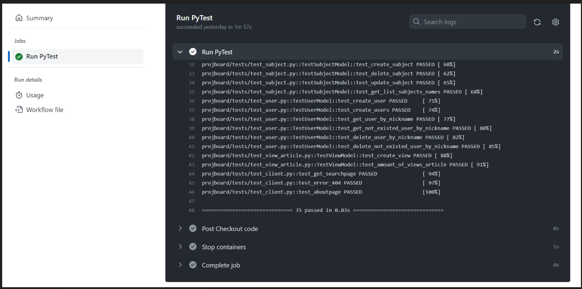

model
view

